Slide 1
In the Name of Jesus: rejoicing in proclaiming His name Philippians 1:12–18
New Hope Bible Fellowship 10/27/2019

Slide 2
Blessed be the Name

Slide 3
Blessed be Your name In the land that is plentiful Where Your streams of abundance flow Blessed be Your name

Slide 4
Blessed be Your name When I'm found in the desert place Though I walk through the wilderness Blessed be Your name

Slide 5
Every blessing You pour out I'll turn back to praise When the darkness closes in, Lord Still I will say

Slide 6
Blessed be the name of the Lord
Blessed be Your name
Blessed be the name of the Lord
Blessed be Your glorious name

Slide 7
Blessed be Your name When the sun's shining down on me When the world's 'all as it should be' Blessed be Your name

Slide 8
Blessed be Your name On the road marked with suffering Though there's pain in the offering Blessed be Your name

Slide 9
Every blessing You pour out I'll turn back to praise When the darkness closes in, Lord Still I will say

Slide 10
Blessed be the name of the Lord
Blessed be Your name
Blessed be the name of the Lord
Blessed be Your glorious name

Slide 11
You give and take away You give and take away My heart will choose to say Lord, blessed be Your name
(x2)

Slide 12
Blessed be the name of the Lord
Blessed be Your name
Blessed be the name of the Lord
Blessed be Your glorious name

Slide 13
Jesus Name above All Names

Slide 14
Jesus, name above all names
Beautiful Savior, glorious Lord.
Emmanuel, God is with us.
Blessed Redeemer, Living word.
(x2)

Slide 15
Emmanuel, God is with us.
Blessed Redeemer, Living word.

Slide 16
Lord I lift your Name on High

Slide 17
Lord, I lift Your name on high
Lord, I love to sing Your praises
I'm so glad You're in my life
I'm so glad You came to save us

Slide 18
You came from Heaven to earth to show the way
From the earth to the cross my debt to pay
From the cross to the grave
From the grave to the sky
Lord, I lift Your name on high

Slide 19
Lord, I lift Your name on high
Lord, I love to sing Your praises
I'm so glad You're in my life
I'm so glad You came to save us

Slide 20
You came from Heaven to earth to show the way
From the earth to the cross my debt to pay
From the cross to the grave
From the grave to the sky
Lord, I lift Your name on high

Slide 21
Scripture:
Philippians 1:1−5

Slide 22
Thank you in different languages
INDONESIA:
TERIMA KASIH
CHINA:
XIEXIE
SHONA:
MAZVITA
KOREAN:
GAMSAHAMNIDA
ETHIOPIAN (AMHARIC):
AMESEGINALEHU
JAPANESE:
ARIGATO
PORTUGUESE:
OBRIGADO/OBRIGADA
THAI:
KOB KHUN KRAB/ KOB KHUN KA
CANTONESE: DO ZE

Slide 23
In the Name of Jesus: rejoicing in proclaiming His name Philippians 1:12–18

Slide 24
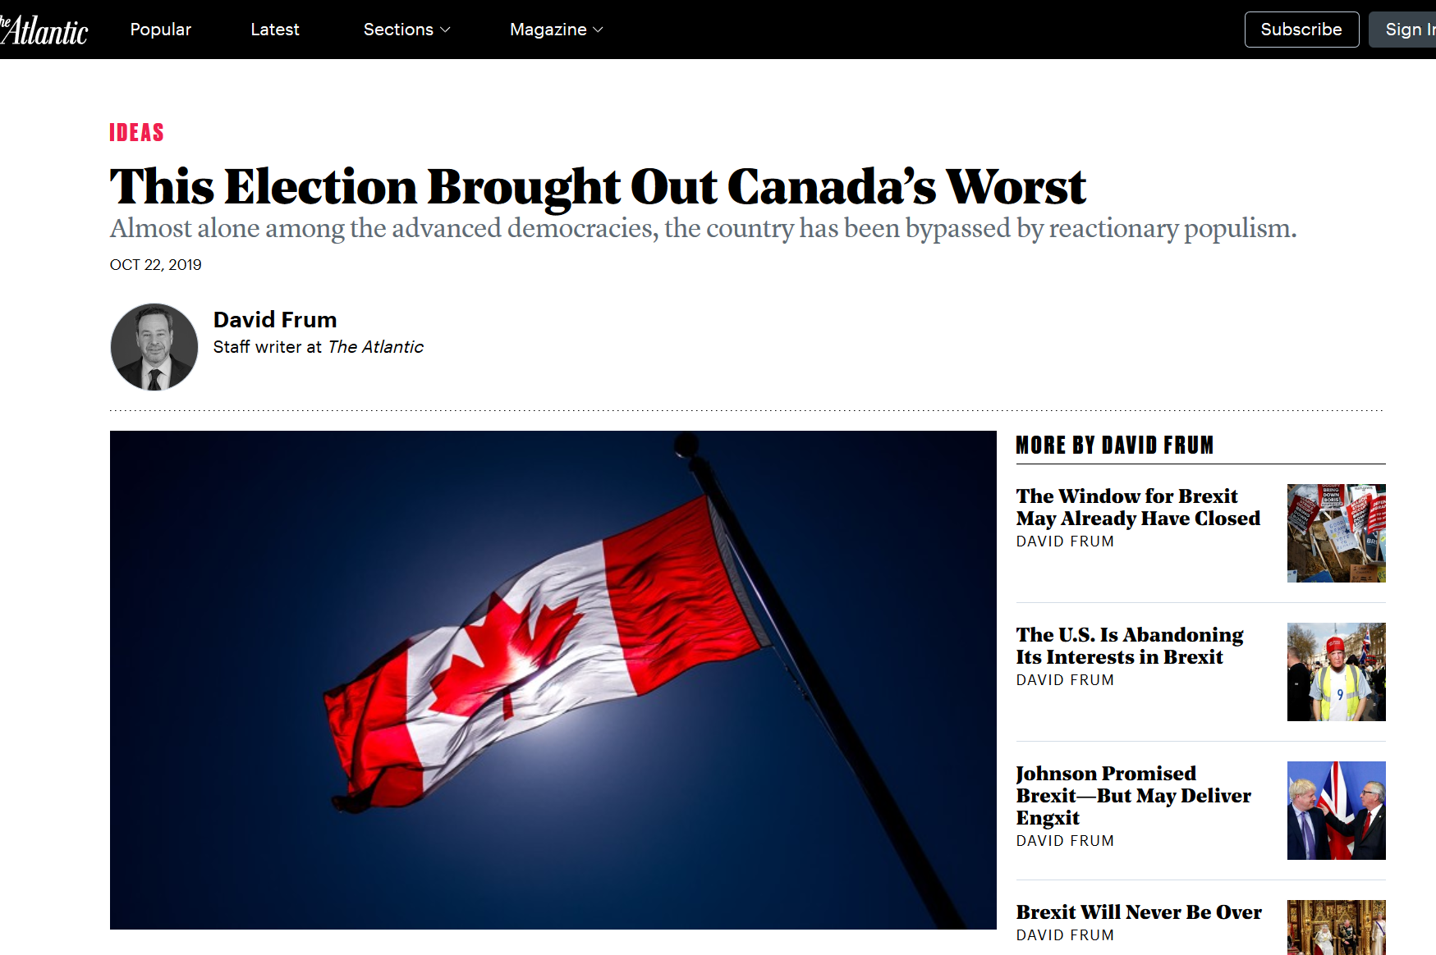

Slide 25
The Rev. Bill Hybels, right, of the Willow Creek church, who resigned in April, with the Rev. Steve Carter, who stepped down on Sunday, and the Rev. Heather Larson, who resigned Wednesday. Credit...Willow Creek Community Church

Slide 26
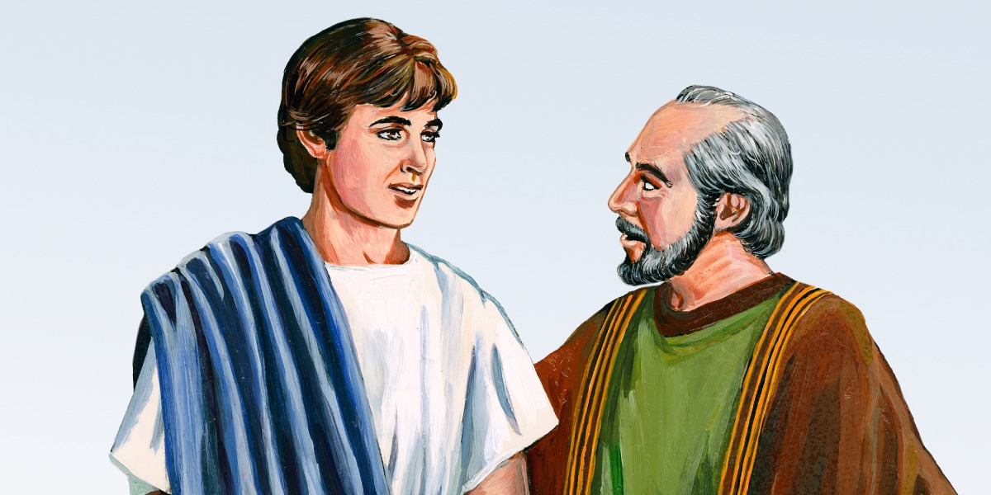
“I hope in the Lord Jesus to send Timothy to you soon, so that I may be cheered by news of you. I have no one like him who will be genuinely concerned for your welfare.” (Phil. 2:19–20)

Slide 27
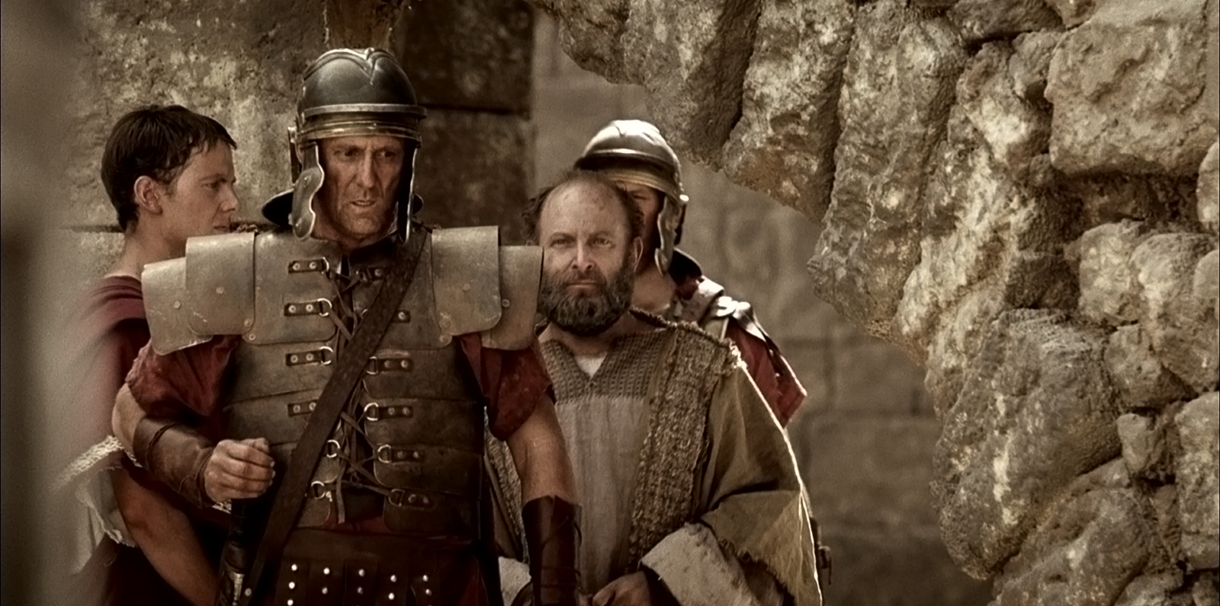
“Just this, that Christ is proclaimed in every way, whether out of false motives or true; and in that I rejoice.” (Phil. 1:18)

Slide 28
Go Tell it on a Mountain

Slide 29
Go tell it on the mountain
Over the hills and everywhere
Go tell it on the mountain
Our Jesus Christ is born

Slide 30
When I was a seeker
I sought both night and day
I asked the Lord to help me
And he showed me the way

Slide 31
Go tell it on the mountain
Over the hills and everywhere
Go tell it on the mountain
Our Jesus Christ is born

Slide 32
He made me a watchman
Upon a city wall
And if I am a Christian
I am the least of all

Slide 33
Go tell it on the mountain
Over the hills and everywhere
Go tell it on the mountain
Our Jesus Christ is born

